Slide 1
WELCOME TO WELLNESS 101
Today is all about You It is all about giving you the information you need to make wise choices for optimal health

Slide 2
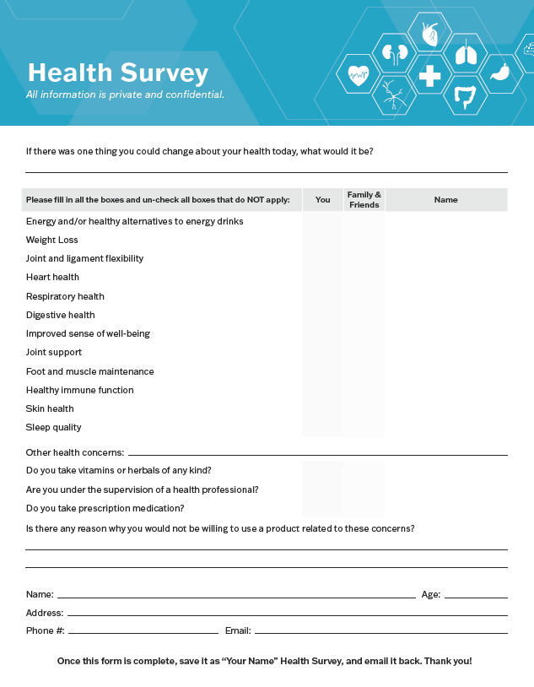
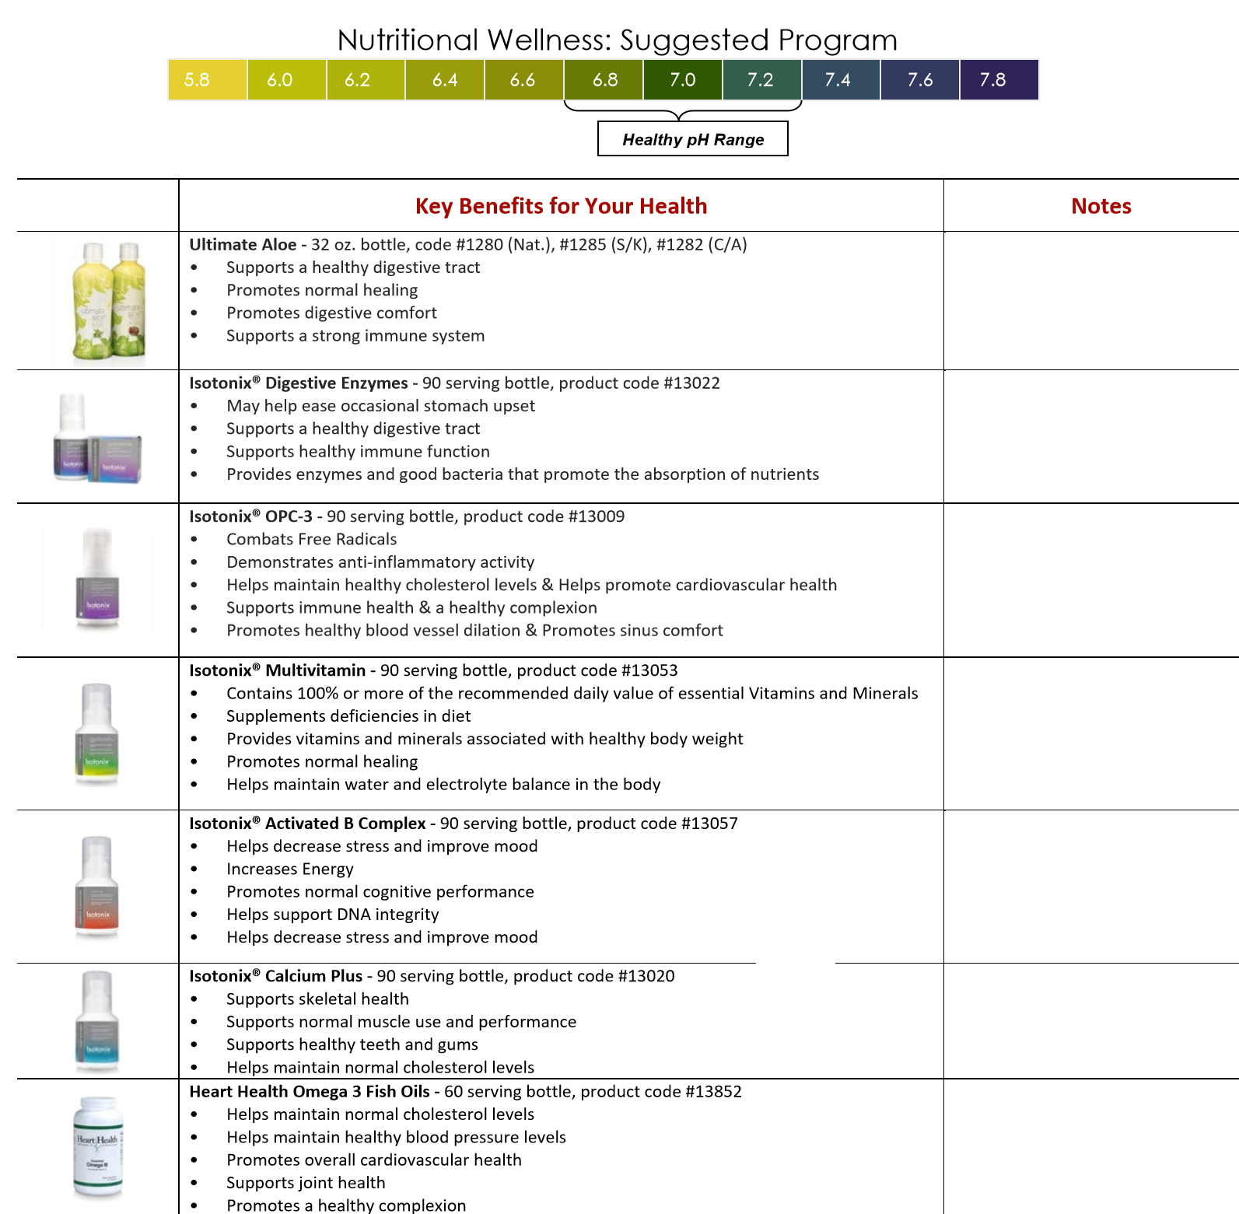
Notes:
Thank them for filling out the survey and let them know we sending the files to them to follow

Slide 3
THESE STATEMENTS HAVE NOT BEEN EVALUATED BY THE FOOD AND DRUG ADMINISTRATION.
THE PRODUCTS DISCUSSED ARE NOT INTENDED TO DIAGNOSE, TREAT, CURE OR PREVENT ANY DISEASE.

Slide 4
OUR GOAL IS EDUCATION IN:
*Improving Gut Health
*Building your Immune system
*Giving natural solutions for inflammation and pain and understanding the role of supplementation
HOW TO TAKE CARE OF YOUR BODY
WHY QUALITY SUPPLEMENTS ARE IMPORTANT
“YOUR BODY IS TALKING, ARE YOU LISTENING?”
INTRODUCTION
TO WELLNESS

Slide 5
LET’S LEARN ABOUT EACH OF YOU
PLEASE TAKE 15 SECONDS AND SHARE
Name and Who Invited You
Where you from
Please share the following: What you'd like to learn today
How our Products have Impacted you

Slide 6
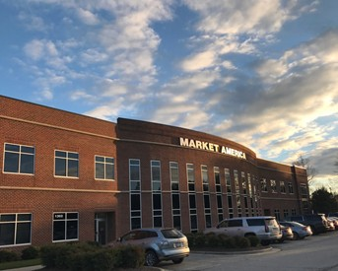
WHO WE ARE
SHOP.COM
PARENT COMPANY: MARKET AMERICA WORLDWIDE
RECOGNITIONS INCLUD TORCH AWARD AND A+ RATING FROM BETTER BUSINESS BUREAU
MULTIPLE PRODUCT DIVISIONS ACROSS BILLION DOLLAR INDUSTRIES
FOUNDED IN 1992 BASED IN GREENSBORO, NC
PRODUCT BROKERAGE AND INTERNET MARKETING COMPANY POWERED BY PEOPLE

Slide 8
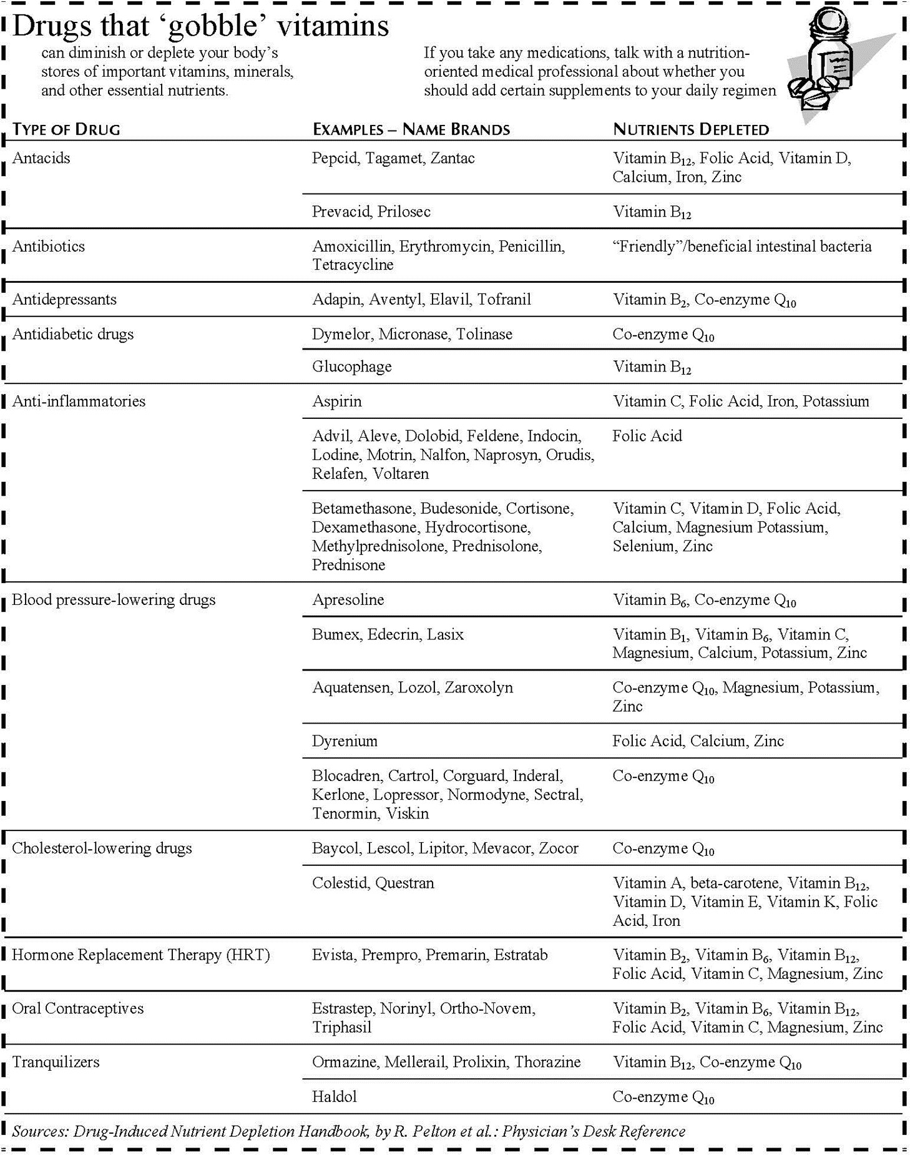
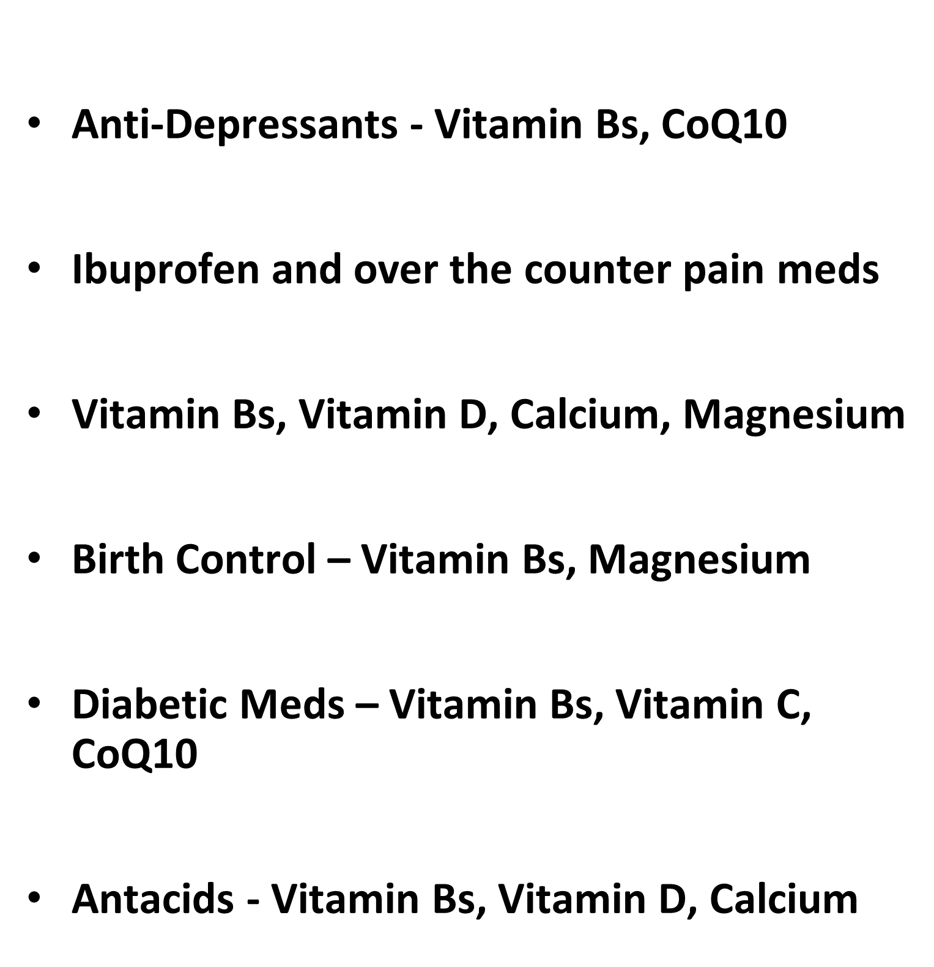
Physicians Desk Reference
Pharmaceuticals CAN Deplete Critical nutrients

Slide 9
LET’S WATCH A SHORT VIDEO

Slide 10
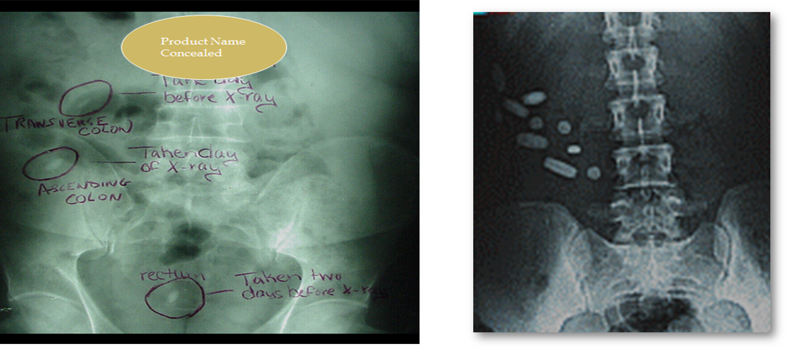
ABSORPTION MATTERS

Slide 12
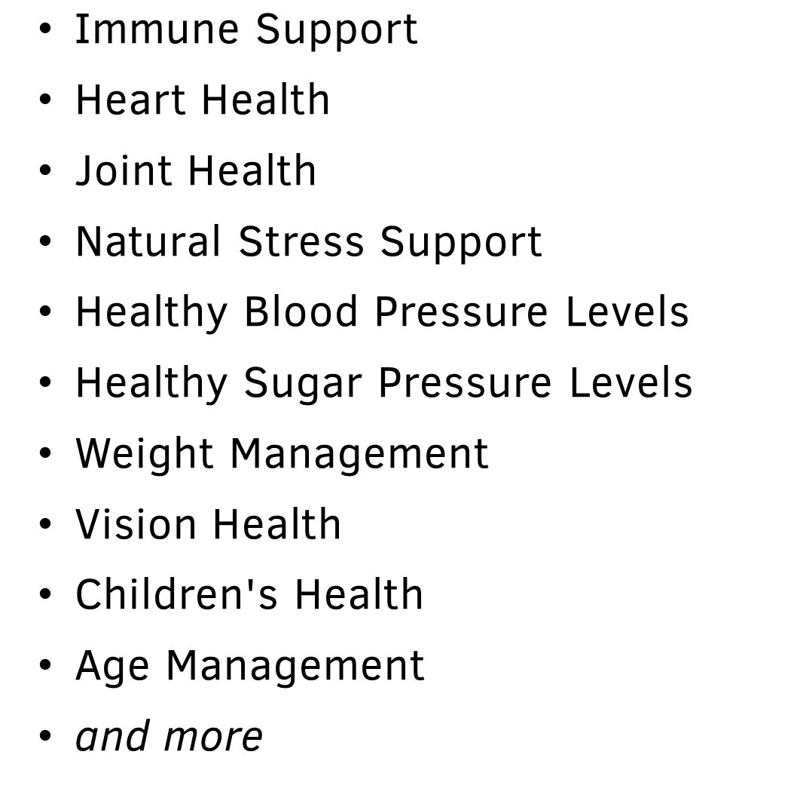
WE HAVE A COMPLETE LINE OF SCIENCE BASED SUPPLEMENTS TO SUPPORT OPTIMAL HEALTH

Slide 13
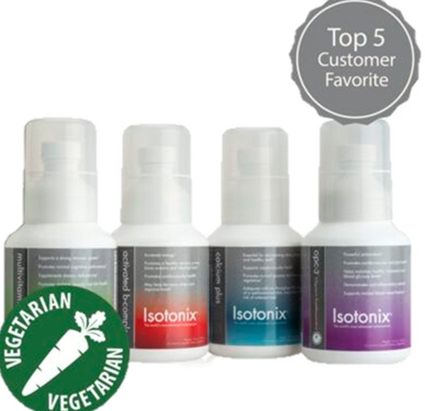
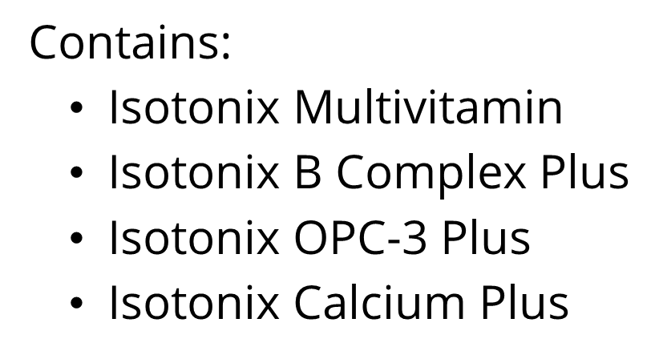
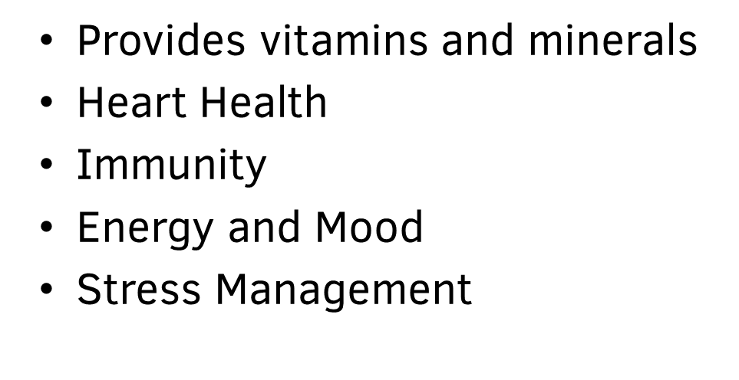
ISOTONIX DAILY ESSENTIAL KIT

Slide 14
WHICH KIT IS RIGHT FOR YOU?

Slide 16
WHICH OPTION WORKS
FOR YOU?
AVAILABLE OPTIONS
TRY A PRODUCT - PICK AND CHOOSE
START YOUR SELF-CARE JOURNEY WITH A WELLNESS KIT
INFORMATION WHOLESALE PRICING

